Slide 1
Architecture Classifications (Mostly using Multiprocessor) (Processor= Control Unit (CU)+Processing Unit/Element(PU/PE+ Memory Shared or Local Memory(LM) or Distributed Memory)
Hwang
Chapter 1

Slide 2
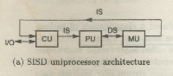
Flynn’s Classification(1972)
Flynn, M. J. (September 1972). "Some Computer Organizations and Their Effectiveness". IEEE Trans. Comput. C–21 (9): 948–960. doi:10.1109/TC.1972.5009071.
(Based on instruction and data streams)
SISD – Single instruction stream over single data stream machines
Sequential machines

Slide 3
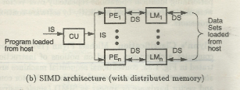
Flynn’s Classification contd..
Many different ways to organize the processors and memory:
SIMD- Single instruction stream over multiple data stream machines
SIMD are Vector computers equipped with scalar and vector hardware(special purpose)

Slide 4
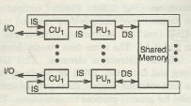
Flynn’s Classification contd..
MIMD- Multiple instruction streams over multiple data streams machines
These Parallel computers have been used for general purpose computations
Processors connected with memory by fast memory bus
or switches

Slide 5
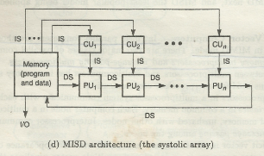
Flynn’s Classification contd..
MISD- Multiple instruction streams over single data streams machines
Same data stream goes through a linear array of processors each executing different instruction stream

Slide 6
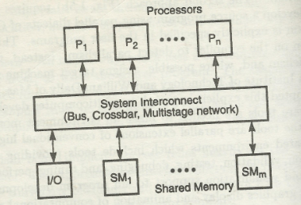
Multiprocessor System- 2 Types
1)Shared Memory Multiprocessor called TIGHTLY COUPLED system, they communicate through shared main memory
Performance degradation when 2 or more processors try to access same memory locations
Can perform with high degree of interaction between tasks, at a higher performance level

Slide 7
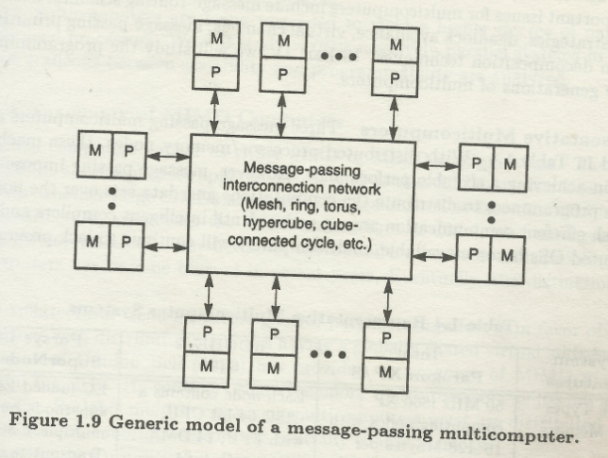
Multiprocessor System- 2 Types
2) Distributed Memory Multiprocessors (also called Multicomputers)
Called LOOSELY COUPLED system, they communicate through message transfer system(MTS)
Multiple inexpensive computers are connected
Efficient when the interaction between task is low

Slide 8
Loosely Coupled vs Strongly Coupled
Loosely coupled architecture means changes in one module / section / component hardly affect the other components and each module is somewhat independent of each other. Technologically independent , Build independent and may be even release independent. Loosely coupled architecture is robust ( as problem doesn't propagate to related application ) and easy to maintain and scale. Example are - SOA ( Service Oriented Architecture ), MVC ( Model View Controller ). On the other hand, tightly coupled architecture promotes inter dependent applications and code. Tighly coupled architecture is fragile as minor issue in one segment can bring the whole architecture down.

Slide 9
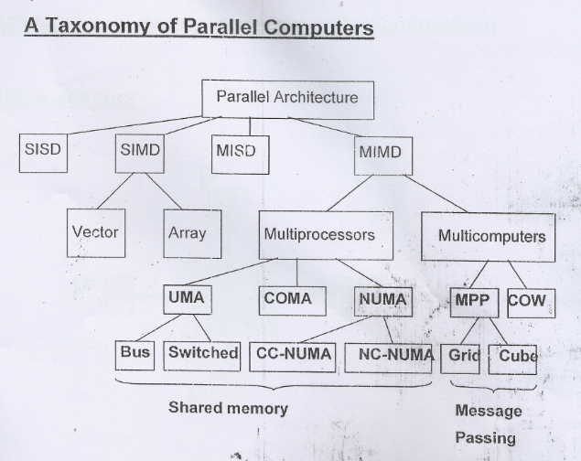
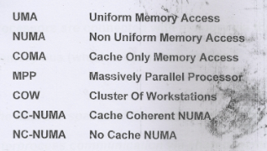
Classification at a Glance

Slide 10
Salient Features of Each Type of MIMD-
Memory architectures
Shared Memory Microprocessors

Slide 11
Shared Memory General Characteristics
Shared Memory Multiprocessor called TIGHTLY COUPLED system, they communicate through shared main memory
Performance degradation when 2 or more processors try to access same memory locations
Can perform with high degree of interaction between tasks, at a higher performance level

Slide 12
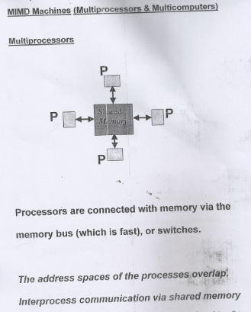
MIMD-Shared Memory Microprocessors-UMA(Uniform Memory Access)
Two or more CPUs within a single computer system. The term also refers to the ability of a system to support more than one processor and/or the ability to allocate tasks between them
Shared
Memory

Slide 13
MIMD- Shared Memory Multiprocessors- UMA(Uniform Memory Access)
UMA means all processors have equal access time to all memory words( –used in general purpose computer)
Each processor may have local cache
1-- Symmetric UMA Multiprocessors
Most commonly represented by Symmetric Multiprocessor (SMP) machines
Identical processors
All processors have equal access to peripheral devices
The OS kernel (executive program) & I/O service routines can be run on any of the processors
Sometimes called CC-UMA - Cache Coherent UMA. Cache coherent means if one processor updates a location in shared memory, all the other processors know about the update. Cache coherency is accomplished at the hardware level.
2—Asymmetric UMA Multiprocessors
Only one or a subset of processors are executive enabled
Remaining processors have no I/O capabilities and are called attached processors(AP)
Aps execute code under supervision of Master processor
Memory sharing of master and APs exist.

Slide 14
UMA Schematic Diagram

Slide 15
MIMD- Shared Memory Multiprocessors- NUMA (non-uniform memory access model)
Often made by physically linking two or more SMPs
One SMP directly access memory of another SMP
Not all processors have equal access time to all memories
The shared memory is physically distributed to all processors
Called Local Memories
Collection of all local memories form global memory address space accessible all processors
Faster to access local memory of a processor by the processor than to access remote memory attached to another processor
Memory access across link /interconnection networks is slower
If cache coherency is maintained, then may also be called CC-NUMA - Cache Coherent NUMA

Slide 16
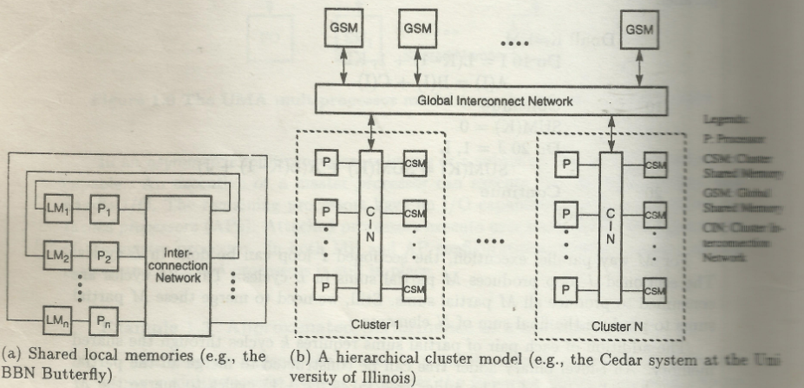
P:Processor, CSM: Cluster Shared Memory , CIN: Cluster Interconnection Network, GSM : Global Shared Memory, LM : (Shared)Local Memory

Slide 17
MIMD- Shared Memory Multiprocessors- NUMA (non-uniform memory access model)
globally shared memory can be added to distributed memory
Memory access pattern :
Local memory access is fastest
Global shared memory access speed comes next
Access to remote processor memory slowest.
Microprocessors can be hierarchically clustered
Each cluster is itself an UMA or NUMA multiprocessor
All processors belonging to the same cluster, uniformly access the cluster shared memory modules

Slide 18
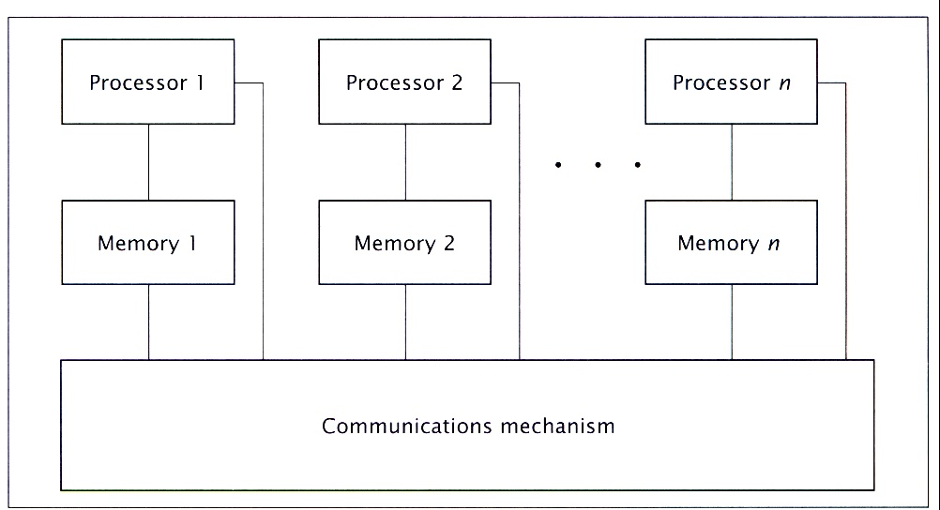
NUMA Schematic Diagram

Slide 19
Multiprocessors- COMA ( Cache Only Memory)
A special case of NUMA
Distributed main memories are converted to cache
All cache form a global address space
Remote cache access assisted by distributed cache directories (D)
Depending on the interconnection network used, sometimes hierarchical directories may be used to locate copies of cache block
Initial data placement is not critical because data eventually migrate to where it will be used

Slide 20
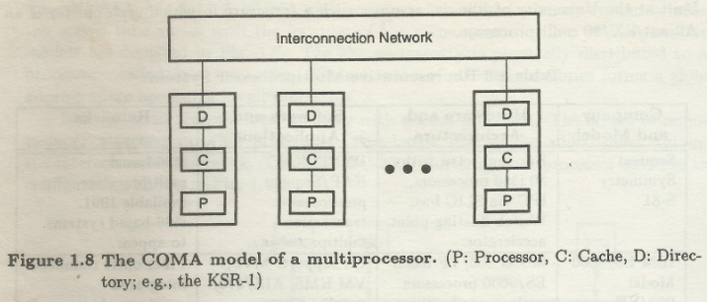
MIMD- Shared Memory Multiprocessors- COMA
(Cache Only Memory Access)

Slide 21
Shared Memory: Pro and Con
Advantages
Global address space provides a user-friendly programming perspective to memory
Data sharing between tasks is both fast and uniform due to the proximity of memory to CPUs
Disadvantages:
Primary disadvantage is the lack of scalability between memory and CPUs. Adding more CPUs can geometrically increases traffic on the shared memory-CPU path, and for cache coherent systems, geometrically increase traffic associated with cache/memory management.
Programmer responsibility for synchronization constructs that insure "correct" access of global memory.
Expense: it becomes increasingly difficult and expensive to design and produce shared memory machines with ever increasing numbers of processors.

Slide 22
Salient Features of Each Type of MIMD- Memory architectures of Distributed Memory Multiprocessors/Multicomputers

Slide 23
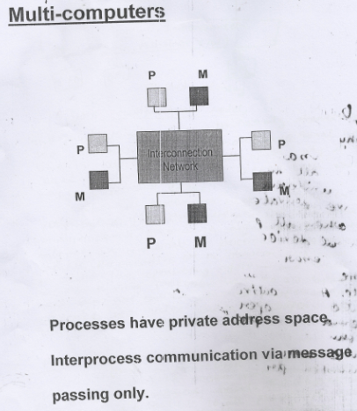
Multicomputers
Interconnection
Network)
Inexpensive computers (Each processor with its own memory unit) connected by LAN.
Clusters of computer

Slide 24
Distributed Memory
Distributed memory system require a communication network to connect inter processor memory
Processors have their own memory. Memory address in one processor do not map to another processor(No global address across all processors)
Each processor works independently with its own memory . Changes made in its own memory do not have effect on the memory of other processors . Hence no cache coherence apply.

Slide 25
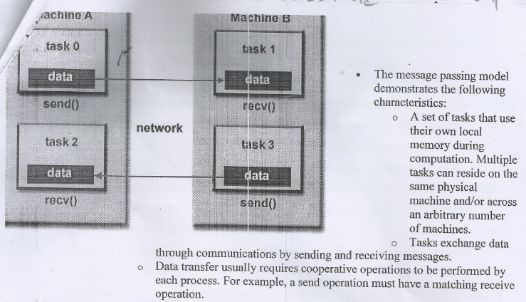
Message Passing Model

Slide 26
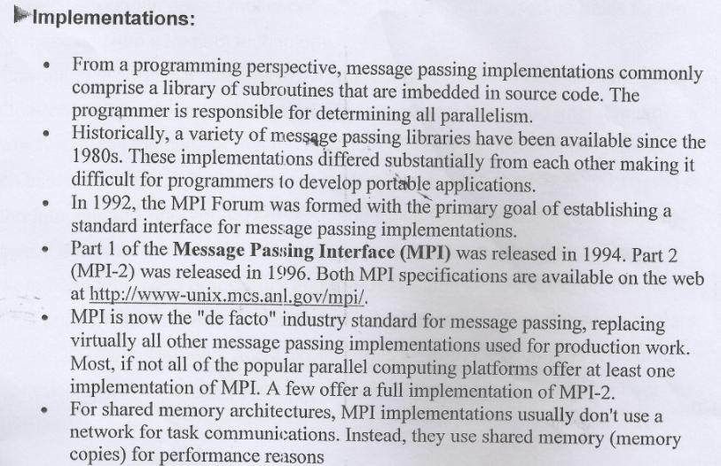
Message Passing Implementation

Slide 27
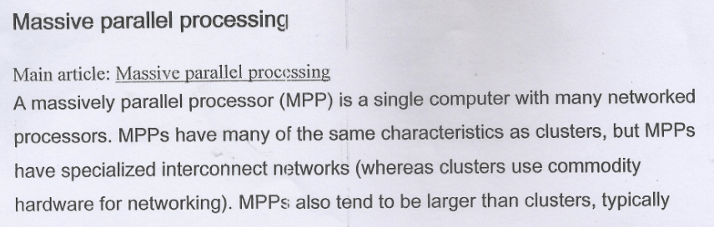
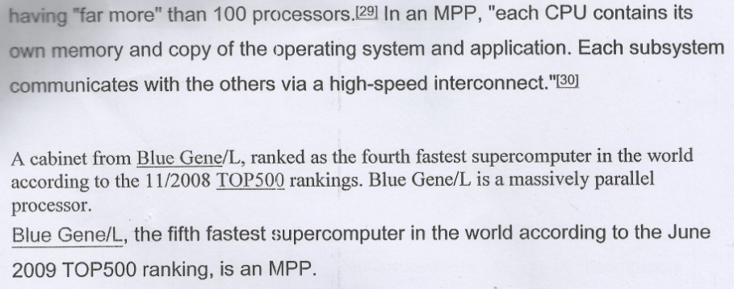
Massively Parallel Computer

Slide 28
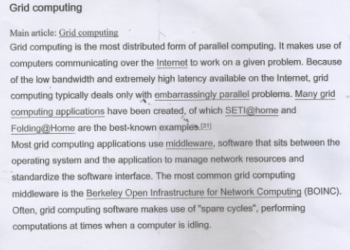

Slide 29
Distributed Memory: Pro and Con
Advantages
Memory is scalable with number of processors. Increase the number of processors and the size of memory increases proportionately.
Each processor can rapidly access its own memory without interference and without the overhead incurred with trying to maintain cache coherency.
Cost effectiveness: can use commodity, off-the-shelf processors and networking.
Disadvantages
The programmer is responsible for many of the details associated with data communication between processors.
It may be difficult to map existing data structures, based on global memory, to this memory organization.
Non-uniform memory access (NUMA) times

Slide 30
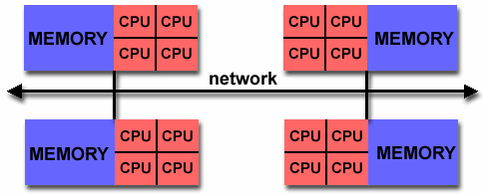
Hybrid Distributed-Shared Memory
The largest and fastest computers in the world today employ both shared and distributed memory architectures.
The shared memory component is usually a cache coherent SMP machine. Processors on a given SMP can address that machine's memory as global.
The distributed memory component is the networking of multiple SMPs. SMPs know only about their own memory - not the memory on another SMP. Therefore, network communications are required to move data from one SMP to another.
Current trends seem to indicate that this type of memory architecture will continue to prevail and increase at the high end of computing for the foreseeable future.
Advantages and Disadvantages: whatever is common to both shared and distributed memory architectures.

Slide 32
Different Types of Uniprocessor Computers
Von Neumann Architecture
Slow due to sequential execution of instructions in programs
Fast Pipelined Instruction execution, pipelined arithmetic computations and memory access
Useful in performing identical operations repeatedly over vector data stings (processor with multiple functional units)

